Slide 1

Agenda Items
Introduction to Data Structures and Algorithms
Arrays: Basics and Advanced Concepts
Array Examples and Use Cases
Notes:
--- We will begin with an introduction to data structures and algorithms, discussing their definitions and significance. Following that, we will dive into arrays, covering their basics, advanced concepts, examples, and use cases. Next, we will explore linked lists, their structure, operations, and applications. Finally, we'll compare arrays and linked lists to help you choose the right data structure for your needs. Image source: Microsoft 365 content library

Slide 2
Introduction to Data Structures and Algorithms
Notes:
Data structures are ways to organize and store data efficiently, while algorithms are step-by-step procedures for solving problems. Understanding these concepts is essential for optimizing performance in computer science.

Slide 3
Definition and Importance
What is a Data Structure?
A data structure is a specialized format for organizing and storing data efficiently in computer science.
Importance of Data Structures
Data structures are essential for managing large datasets and influence the efficiency of algorithms and applications.
Impact on Algorithms
Well-chosen data structures can significantly enhance the performance of algorithms in computing tasks.
Notes:
--- A data structure is a specialized format for organizing, processing, and storing data. They are critical for managing large amounts of data effectively, impacting the performance of algorithms and applications. Image source: Microsoft 365 content library

Slide 4
Overview of Common Data Structures
Arrays
Arrays are a collection of elements identified by index or key, allowing efficient data access and storage.
Linked Lists
Linked lists consist of nodes where each node points to the next, allowing for dynamic memory allocation and flexibility.
Stacks
Stacks are data structures that follow the Last In First Out (LIFO) principle, useful for reversing data or tracking function calls.
Queues
Queues are data structures that follow the First In First Out (FIFO) principle, ideal for scheduling tasks or processing data in order.
Trees and Graphs
Trees and graphs are hierarchical structures used to represent relationships and connections, enabling efficient data organization and retrieval.
Notes:
Common data structures include arrays, linked lists, stacks, queues, trees, and graphs. Each structure has unique characteristics, advantages, and use cases, making them suitable for different types of problems.

Slide 5
Arrays: Basics and Advanced Concepts
Notes:
Arrays are a fundamental data structure that store elements of the same type in a contiguous block of memory. They provide fast access to elements using an index, making them a popular choice for many applications.

Slide 6
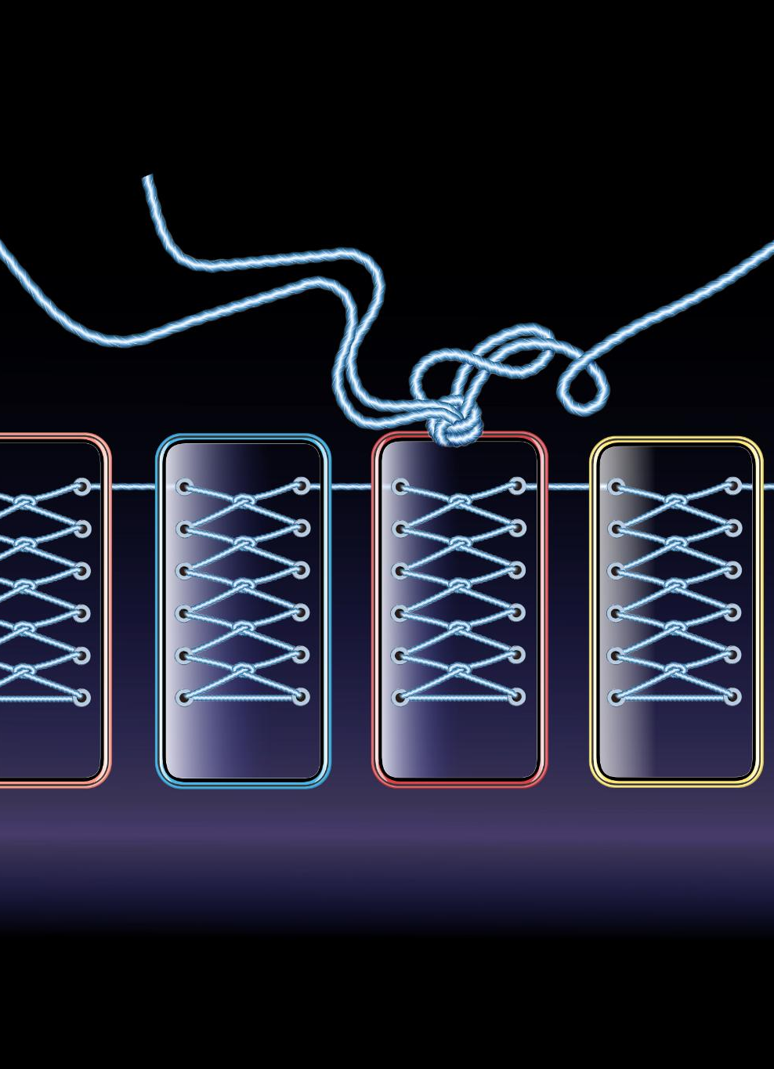
Definition and Structure of Arrays
Definition of Array
An array is a data structure that holds a collection of items stored in contiguous memory locations.
Fixed Size
The size of an array is determined at the time of creation, which means it cannot grow or shrink dynamically.
Efficient Access
Arrays provide efficient access to their elements by using an index, allowing for quick retrieval and modification of data.
Notes:
--- An array is a collection of items stored at contiguous memory locations. The size of an array is fixed at the time of creation, making it efficient for accessing elements by their index. Image source: Microsoft 365 content library

Slide 7
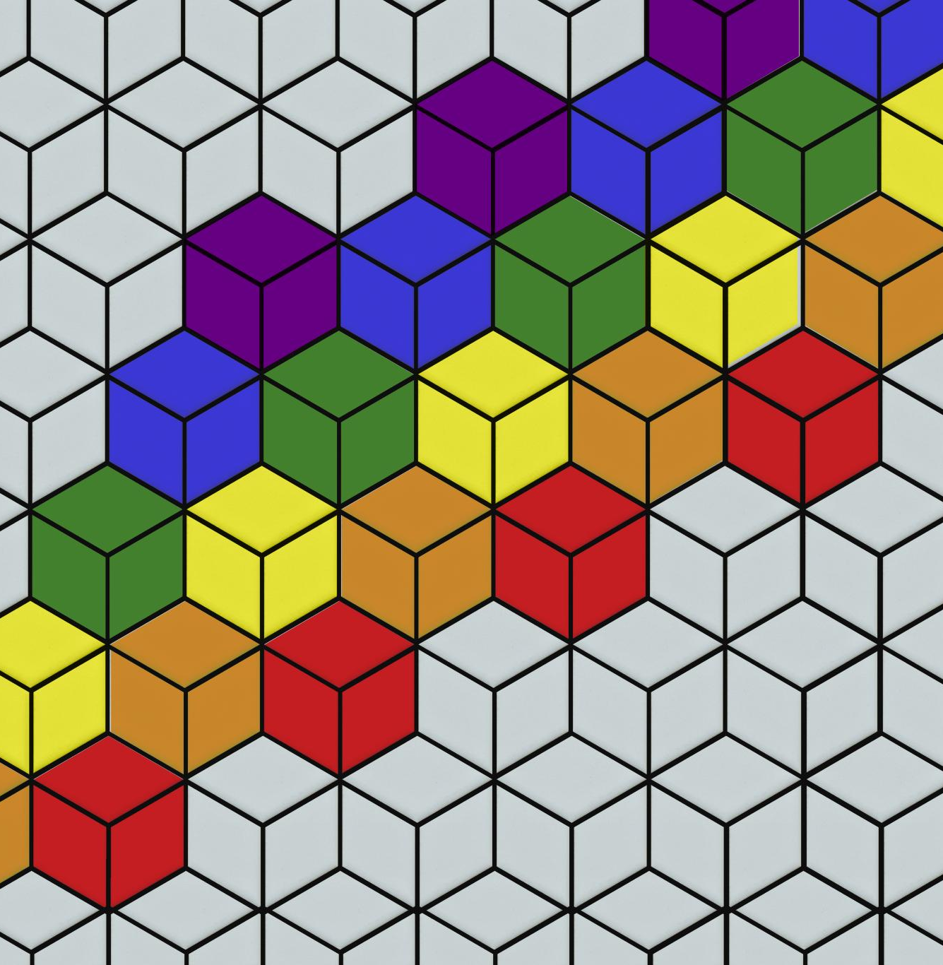
Types of Arrays (One-Dimensional, Multi-Dimensional)
One-Dimensional Arrays
One-dimensional arrays are linear structures that store a sequence of elements in a single row or column.
Multi-Dimensional Arrays
Multi-dimensional arrays can represent more complex data structures, such as matrices, allowing for multiple rows and columns.
Notes:
--- Arrays can be classified into one-dimensional arrays, which hold a linear list of elements, and multi-dimensional arrays, which can represent matrices or more complex data structures. Image source: Microsoft 365 content library

Slide 8
Operations on Arrays (Insertion, Deletion, Traversal)
Array Insertion
Insertion involves adding a new element to an array, requiring shifts of existing elements based on the index.
Array Deletion
Deletion removes an element from an array, which can lead to shifts of remaining elements to fill the gap.
Array Traversal
Traversal involves accessing each element of an array in order, which is essential for processing data efficiently.
Notes:
--- Key operations on arrays include insertion, deletion, and traversal. Each operation has specific complexities and considerations that can impact performance. Image source: Microsoft brand library

Slide 9
Array Examples and Use Cases
Notes:
Arrays are widely used in various applications due to their simplicity and efficiency. In this section, we will look at practical examples of array usage.

Slide 10

Example: Building a To-Do List Application
Managing Tasks with Arrays
Arrays allow users to efficiently manage tasks in a to-do list application, providing easy access and manipulation of tasks.
Adding and Removing Tasks
Users can seamlessly add new tasks or remove completed ones, ensuring their to-do list is always up-to-date.
Displaying Tasks
The application can display tasks in a user-friendly format, making it easy for users to track their progress.
Notes:
--- A common use case for arrays is to manage a to-do list application. By using an array to store tasks, users can easily add, remove, and display their tasks efficiently. Image source: Microsoft 365 content library

Slide 11
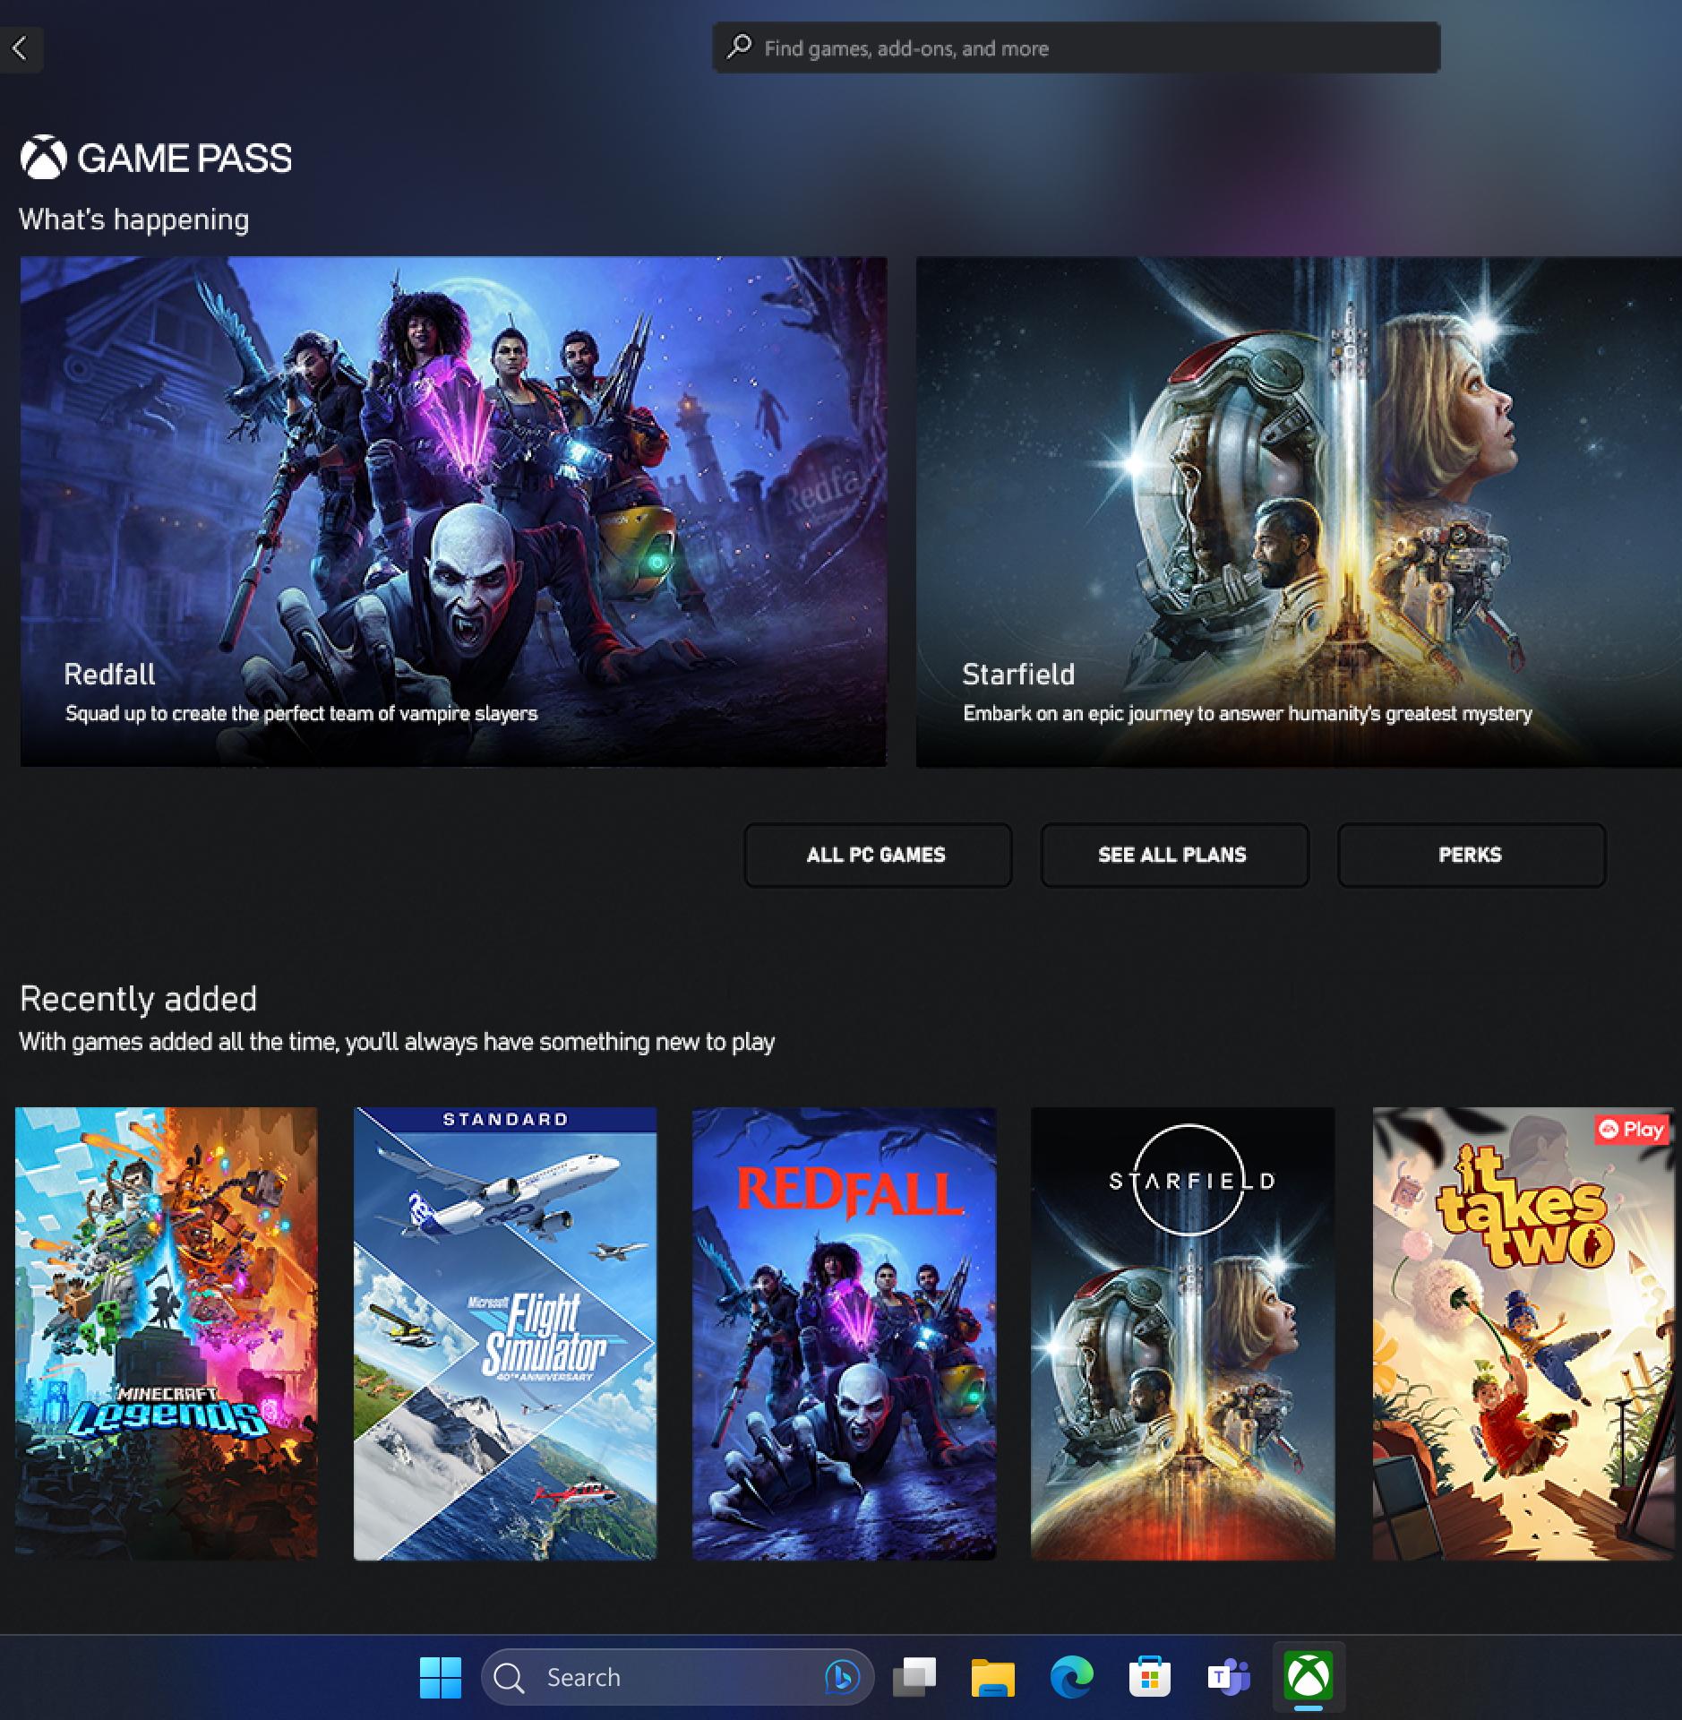
Industry Use Case: Arrays in Game Development
Efficient Game Object Management
Arrays enable efficient management of game objects by allowing developers to quickly access and manipulate collections of sprites and items.
Quick Access and Manipulation
Using arrays in game development allows for rapid access and manipulation of game objects, enhancing gameplay performance and responsiveness.
Notes:
--- In game development, arrays are often used to manage collections of game objects, such as sprites or items, allowing for quick access and manipulation of these objects during gameplay. Image source: Microsoft brand library

Slide 12

Advantages and Limitations of Arrays
Fast Access Time
Arrays provide quick access to elements through indexed positions, making data retrieval efficient and straightforward.
Ease of Use
Arrays are simple to implement and manipulate, offering a user-friendly way to store multiple items of the same type.
Fixed Size
One limitation of arrays is their fixed size, which can lead to insufficient storage space or wasted memory.
Memory Waste
If an array is not fully utilized, it can result in wasted memory, which can be inefficient for large datasets.
Notes:
--- Arrays offer advantages such as fast access time and ease of use. However, they also have limitations, including fixed size and the potential for wasted memory if not fully utilized. Image source: Microsoft 365 content library

Slide 13
Example walkthrough
Given an array arr[] of positive integers, where each value represents the number of chocolates in a packet. Each packet can have a variable number of chocolates. There are m students, the task is to distribute chocolate packets among m students such that - i. Each student gets exactly one packet. ii. The difference between maximum number of chocolates given to a student and minimum number of chocolates given to a student is minimum and return that minimum possible difference.
Examples:
Input: arr = [3, 4, 1, 9, 56, 7, 9, 12], m = 5 Output: 6 Explanation: The minimum difference between maximum chocolates and minimum chocolates is 9 - 3 = 6 by choosing following m packets :[3, 4, 9, 7, 9]. Input: arr = [7, 3, 2, 4, 9, 12, 56], m = 3 Output: 2 Explanation: The minimum difference between maximum chocolates and minimum chocolates is 4 - 2 = 2 by choosing following m packets :[3, 2, 4].Input: arr = [3, 4, 1, 9, 56], m = 5 Output: 55 Explanation: With 5 packets for 5 students, each student will receive one packet, so the difference is 56 - 1 = 55.
Constraints: 1 ≤ m <= arr.size ≤ 10⁵ 1 ≤ arr[i] ≤ 10⁹

Slide 14
Do it yourself – Practice problems
Problem | Complexity
https://leetcode.com/problems/trapping-rain-water | Hard
https://leetcode.com/problems/3sum | Medium
https://leetcode.com/problems/median-of-two-sorted-arrays | Hard
https://leetcode.com/problems/container-with-most-water | Medium
https://leetcode.com/problems/search-in-rotated-sorted-array | Medium
https://leetcode.com/problems/number-of-islands | Medium
https://leetcode.com/problems/merge-intervals | Medium
https://leetcode.com/problems/find-the-duplicate-number | Medium
https://leetcode.com/problems/sliding-window-maximum | Hard
https://leetcode.com/problems/coin-change | Medium
https://leetcode.com/problems/jump-game | Medium

